Slide 1


EMPLOYEE ATTRITION ANALYSIS
NAME : SHALINI R
REG NO : 12220700
DEPARTMENT : B.COM(CORPORATE
SECTRETARYSHIP)
COLLEGE NAME : VALLAL P.T.LEE C.N.ARTS AND SCIENCE COLLEGE .

Slide 2
AGENDA:
MEANING OF ATTRITION
EMPLOYEE ATTRITION VS
EMPLOYEE TURNOVER
ATTRITION RATE
TYPES OF EMPLOYEE ATTRITION
CALCULATION OF EMPLOYEE ATTRITION
USES OF ATTRITION
EMPLOYEE ATTRITION USING BY EXCEL

Slide 3
ATTRITION
Attrition Meaning:
Attrition is the departure of employees from the organization for any reason (voluntary or involuntary), including resignation, termination, death or retirement. Attrition rate is the rate at which employees leave an organization divided by the average number of employees at the organization over a given period of time.

Slide 4
EMPLOYEE ATTRITION VS EMPLOYEE TURNOVER
Although similar, employee attrition and employee turnover are not the same.
The biggest difference between employee attrition and employee turnover is that turnover takes into account all terminations. This includes positions that are refilled.
On the other hand, employee attrition includes all long-term vacancies and position eliminations.
For this reason, it’s possible to have high employee turnover rates and still have a growing company. But if your attrition rates are consistently high, your company is likely shrinking in size.

Slide 5
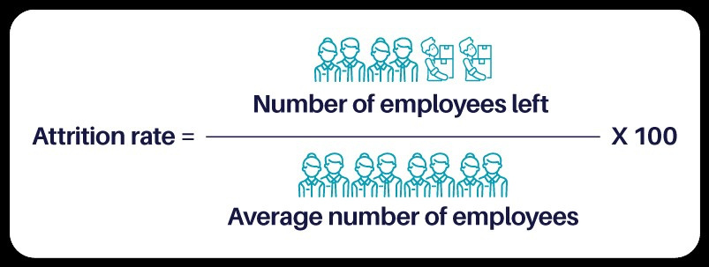
Attrition Rate:

Slide 6
Types of employee attrition
Voluntary attrition | Voluntary attrition takes place when employees choose to leave the company on their own accord, such as for personal reasons or to take a new job, and the employer decides not to replace them or cannot find a replacement. Even situations when the employee believes they have no choice but to resign are still considered voluntary attrition. For example, leaving for health issues or because the work situation is toxic.
Involuntary attrition | When the company makes the decision to part ways with an employee and eliminates their position, it is defined as involuntary attrition. This most commonly happens during reorganization or layoffs. Involuntary attrition through position elimination is the most common form of attrition, as the company decides proactively to eliminate a position. In termination for cause cases, such as poor performance or misconduct, the employer may decide afterward to leave the job vacant.

Slide 7
How to calculate employee attrition rate:
Calculating a company’s employee attrition rate is fairly easy. Below is a practical example:
To start, find the average number of employees. We’ll use 95 people for the purpose of our example.
Next, let’s work on an average by month.
Now, consider the number of employees who left unfilled positions over the course of the particular month. For our example, we will use 8. Now divide 8 by 95 to reach the average headcount: 0.0842.
Next, multiply this average by 100 = 8.42%.

Slide 8

ATTRITION

Slide 9
Is employee attrition always bad?
If a certain position has become unnecessary, it can be eliminated when the person currently filling it leaves or transfers.
When financial struggles or redirection of the business require reducing labor costs, not filling vacant roles can be the starting point.
Dividing the responsibilities of an unfilled position to other team members can provide new opportunities for growth and development.

Slide 10
Is employee attrition always bad?
If a certain position has become unnecessary, it can be eliminated when the person currently filling it leaves or transfers.
When financial struggles or redirection of the business require reducing labor costs, not filling vacant roles can be the starting point.
Dividing the responsibilities of an unfilled position to other team members can provide new opportunities for growth and development.

Slide 11
Month | Opening count | New joiner | Exit employee | Balance | Ave no.of. Employees | Attrition %
Jan-21 | 150.00 | 30 | 10 | 170 | 160 | 6.25
Feb-21 | 170.00 | 15 | 4 | 181 | 176 | 6.28
Mar-21 | 181.00 | 7 | 5 | 183 | 182 | 2.75
Apr-21 | 183.00 | 19 | 12 | 190 | 187 | 6.43
May-21 | 190.00 | 17 | 10 | 197 | 194 | 5.17
Jun-21 | 197.00 | 19 | 2 | 214 | 206 | 0.97
Jul-21 | 214.00 | 15 | 1 | 221 | 218 | 3.68
Aug-21 | 221.00 | 15 | 1 | 235 | 228 | 0.44
Sep-21 | 235.00 | 12 | 13 | 234 | 235 | 5.54
Oct-21 | 234.00 | 17 | 2 | 2490 | 242 | 0.83
Nov-21 | 249.00 | 20 | 12 | 257 | 253 | 4.74
Dec-21 | 257.00 | 16 | 13 | 260 | 259 | 5.03

Slide 12
